Slide 1
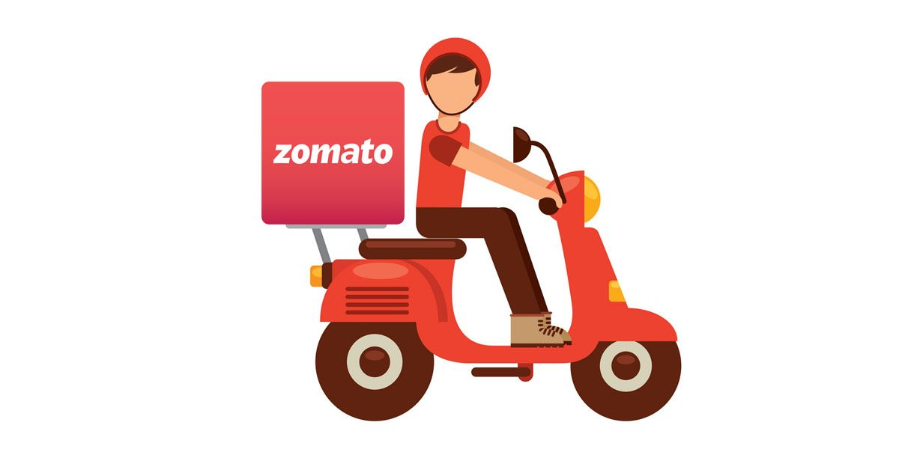
Zomato Data Analysis
Sudhanshu Bhawsar
30-06-2024

Slide 2

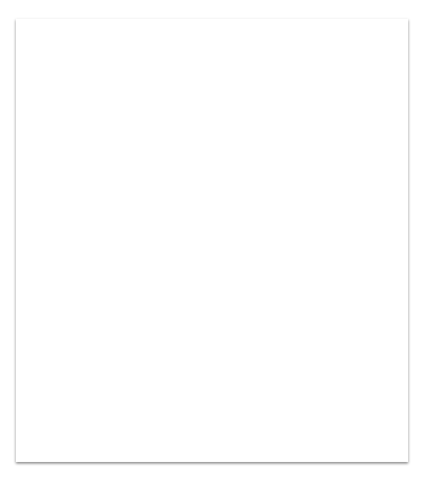
About zomato
Zomato is a global restaurant discovery and food delivery platform headquartered in Gurgaon, India. Founded in 2008 by Deepinder Goyal and Pankaj Chaddah, Zomato has grown to become one of the leading names in the food tech industry.

Slide 3
Table Content
About
Problem Statement
Market Research
Suggested Countries
Expenditure on Food
Dashboard

Slide 4
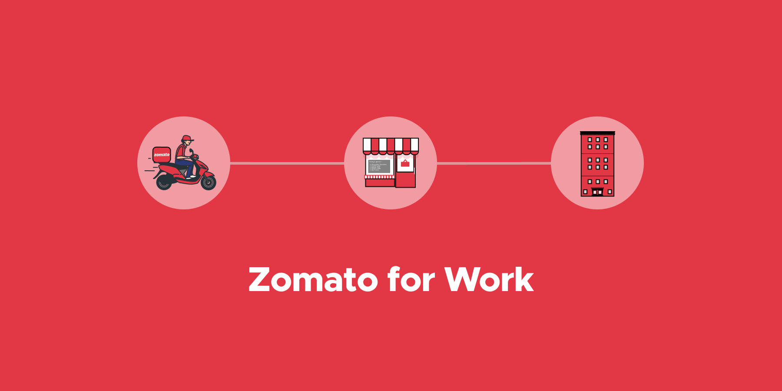
Problem Statement
Zomato team wants to expand own business, opening new restaurants in different country to capture the maximum customers of different price range and cuisines according to country.

Slide 5
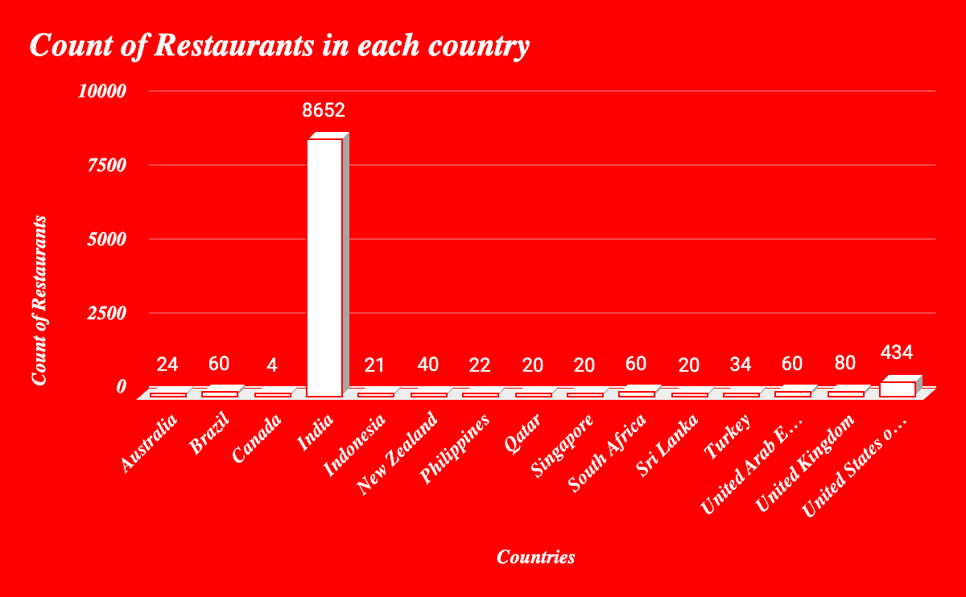
Market Research
Total Countries = 15
Total Cuisines = 1826
In the world total 9551 restaurants.
Price range is 1 to 4

Slide 6
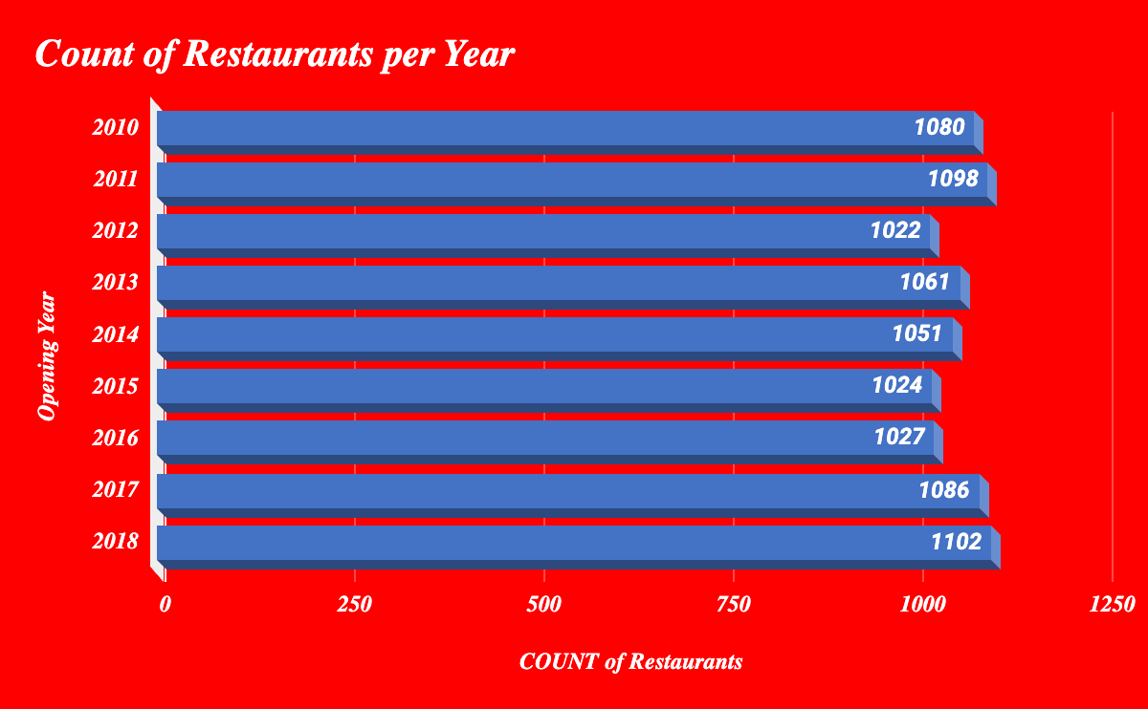
Market Research
Lowest Restaurensts in 2012
Highest Restaurants in 2018

Slide 7
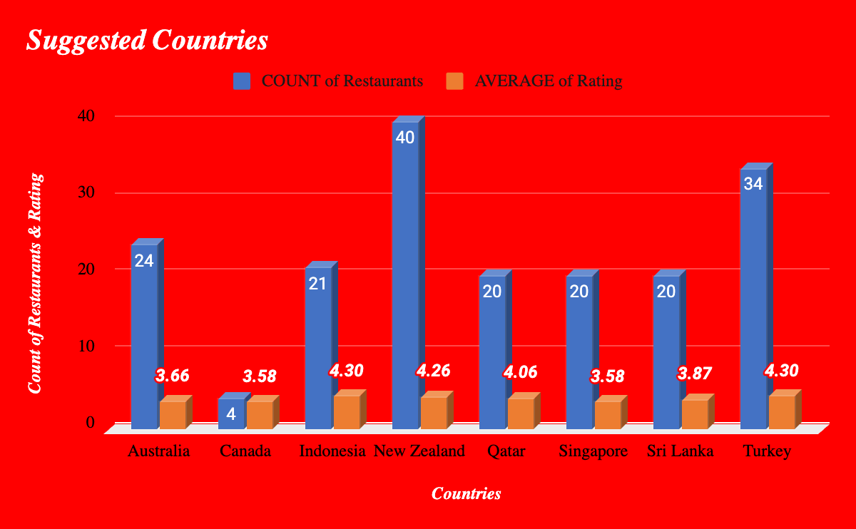
Market Research
Suggested Countries with
Count of restaurants & Average Rating

Slide 8
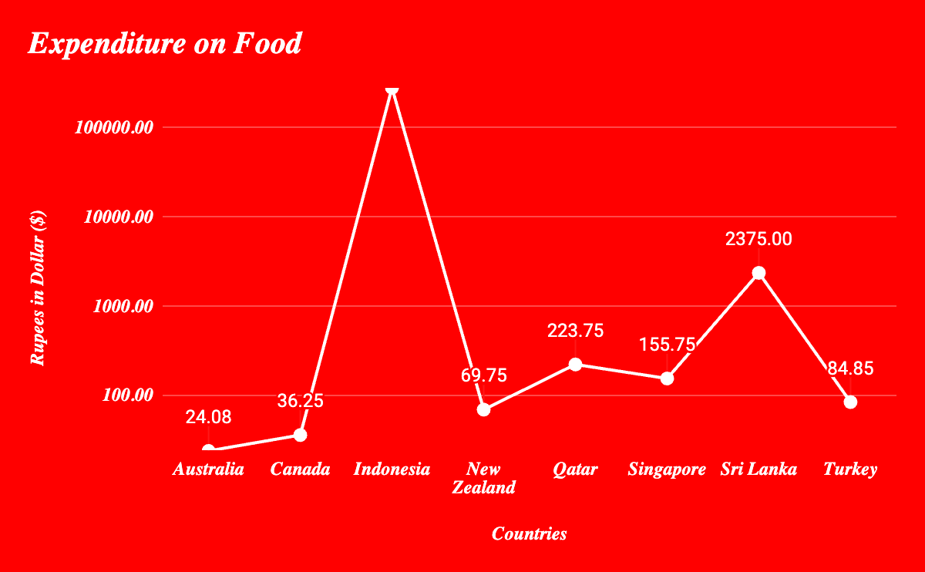
Market Research

Slide 9
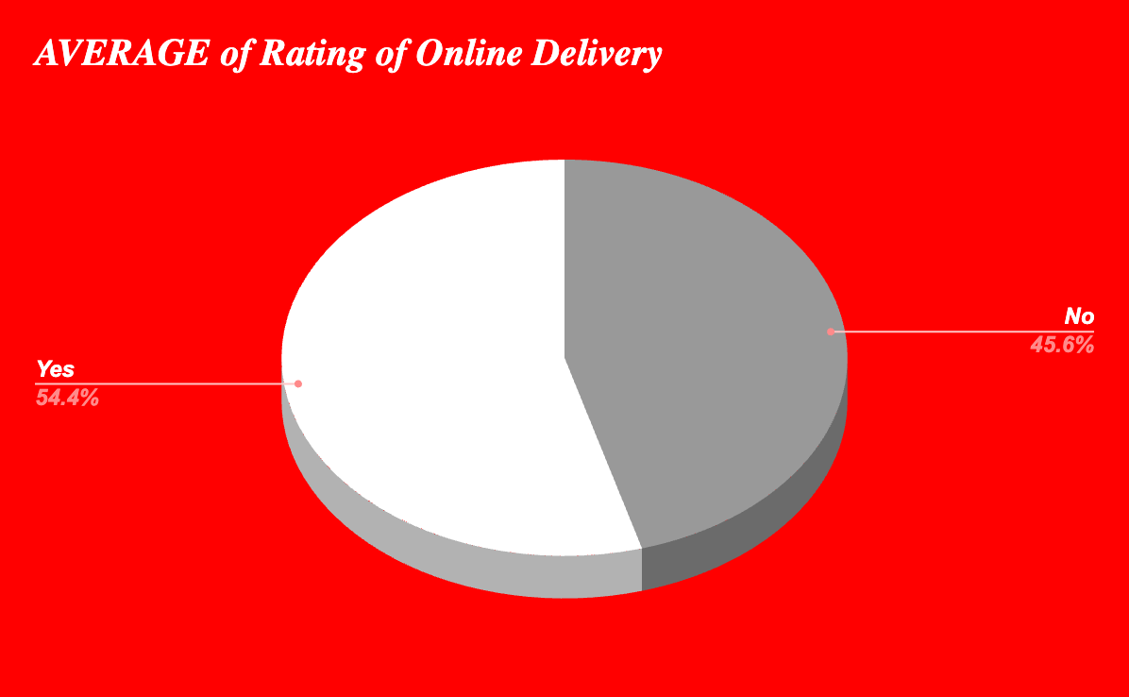
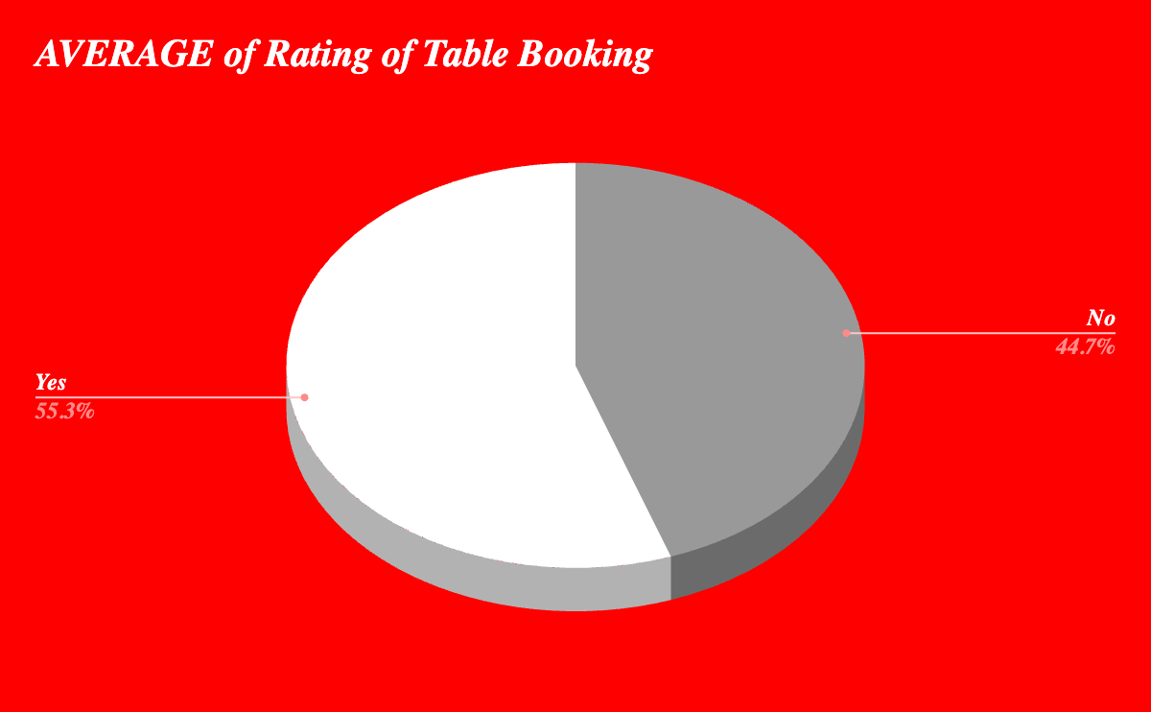
Market Research
The new restaurants have online delivery & online table booking
Average of online table booking is higher 55.3%
Average of online delivery is higher 54.4%

Slide 10
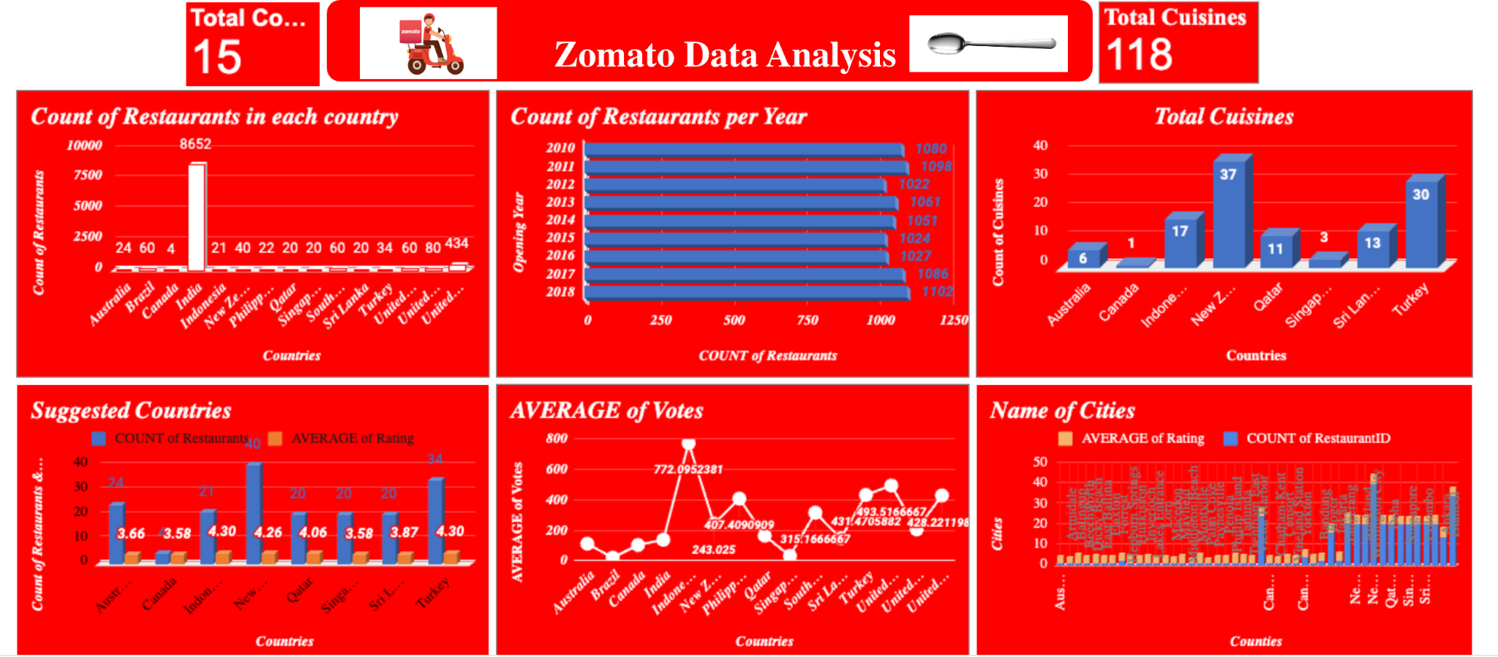
DashBoard

Slide 11
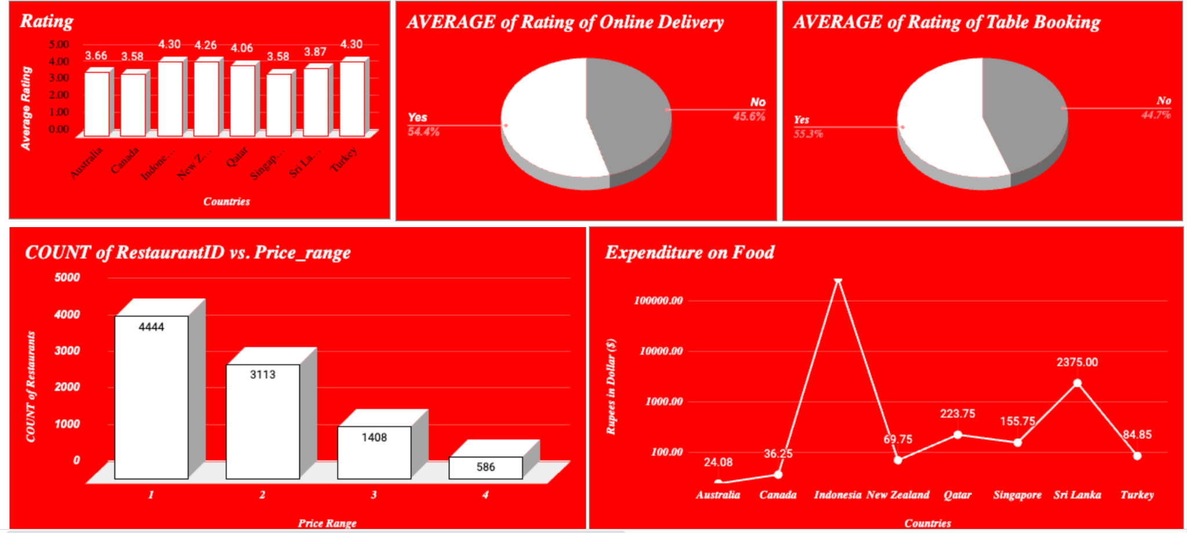
DashBoard

